Slide 1


Unit 1 – Using Objects and Methods
Lesson 6: Creating and Calling an Object’s Methods
Objectives
1.8 Documentation with comments
1.9 Method Signatures
1.14 Calling Instance Methods

Slide 2
Methods as Behavior
Any behaviors we want our objects to have are created using methods

Slide 3
Methods as Behavior
Any behaviors we want our objects to have are created using methods
Methods are blocks of code designed to perform a specific task

Slide 4
Methods as Behavior
Any behaviors we want our objects to have are created using methods
Methods are blocks of code designed to perform a specific task
The method header tells us all the information about a method:

Slide 5
Modifier
modifier
public void speak()
{
}

Slide 6
Modifier
  A private modifier means the method can only be used in the class.
modifier
public void speak()
{
}

Slide 7
Modifier
  A private modifier means the method can only be used in the class.
  A public modifier means the method can be used inside or outside the class
modifier
public void speak()
{
}

Slide 8
Return Type
return type
public void speak()
{
}

Slide 9
Return Type
  Void methods do not return a value
return type
public void speak()
{
}

Slide 10
Return Type
  Void methods do not return a value
  void methods are used to perform actions like printing information or updating attributes
return type
public void speak()
{
}

Slide 11
Return Type
  Void methods do not return a value
  void methods are used to perform actions like printing information or updating attributes
  Non-void methods return a value (and will have a return statement inside the method)
return type
public void speak()
{
}

Slide 12
Return Type
  Void methods do not return a value
  void methods are used to perform actions like printing information or updating attributes
  Non-void methods return a value (and will have a return statement inside the method)
  non-void methods are used to get information or calculate a result
return type
public void speak()
{
}

Slide 13
Method Name
method name
public void speak()
{
}

Slide 14
Method Name
  The method name identifies the method you are using
method name
public void speak()
{
}

Slide 15
Method Name
  The method name identifies the method you are using
  By convention, methods start with a lowercase letter
method name
public void speak()
{
}

Slide 16
Parameters
parameters
public void speak()
{
}

Slide 17
Parameters
  Parameters are values that you pass into a method so it can use them to perform its task
parameters
public void speak()
{
}

Slide 18
Parameters
  Parameters are values that you pass into a method so it can use them to perform its task
  They act like placeholders in the method for the data that you provide when you call the method
parameters
public void speak()
{
}

Slide 19
Parameters
  Parameters are values that you pass into a method so it can use them to perform its task
  They act like placeholders in the method for the data that you provide when you call the method
  Parameters let methods work with different values each time they are called
parameters
public void speak()
{
}

Slide 20
Parameters
  Parameters are values that you pass into a method so it can use them to perform its task
  They act like placeholders in the method for the data that you provide when you call the method
  Parameters let methods work with different values each time they are called
  Non-parameter methods have empty paratheses
parameters
public void speak()
{
}

Slide 21
Parameters
  Parameters are values that you pass into a method so it can use them to perform its task
  They act like placeholders in the method for the data that you provide when you call the method
  Parameters let methods work with different values each time they are called
  Non-parameter methods have empty paratheses
  Parameter methods will identify the data type, followed by an identifier for the value you pass it
parameters
public void speak()
{
}

Slide 22
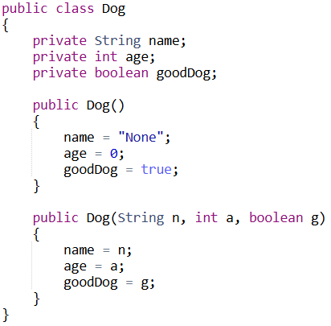
Recall: Our Dog Class

Slide 23
Void Methods in Dog

Slide 24
Void Methods in Dog
public void speak() { System.out.println("Woof Woof!"); }

Slide 25
Void Methods in Dog
public void speak() { System.out.println("Woof Woof!"); }

Slide 26
Void Methods in Dog
public void speak() { System.out.println("Woof Woof!"); }
public void haveBirthday() { age++; }

Slide 27
Void Methods in Dog
public void speak() { System.out.println("Woof Woof!"); }
public void haveBirthday() { age++; }

Slide 28
Non-Void Methods in Dog

Slide 29
Non-Void Methods in Dog
public String sayName() { return "My name is " + name; }

Slide 30
Non-Void Methods in Dog
public String sayName() { return "My name is " + name; }

Slide 31
Non-Void Methods in Dog
public String sayName() { return "My name is " + name; }
public int peopleYears() { return age * 7; }

Slide 32
Non-Void Methods in Dog
public String sayName() { return "My name is " + name; }
public int peopleYears() { return age * 7; }

Slide 33
Void Methods with Parameters in Dog

Slide 34
Void Methods with Parameters in Dog
public void changeName(String newName) { name = newName; }

Slide 35
Void Methods with Parameters in Dog
public void changeName(String newName) { name = newName; }

Slide 36
Void Methods with Parameters in Dog
public void changeName(String newName) { name = newName; }
public void changeGoodness(boolean isGood) { goodDog = isGood; }

Slide 37
Void Methods with Parameters in Dog
public void changeName(String newName) { name = newName; }
public void changeGoodness(boolean isGood) { goodDog = isGood; }

Slide 38
Non-Void Methods with Parameters in Dog

Slide 39
Non-Void Methods with Parameters in Dog
public String getDescription(String separator) { return name + separator + "Age: " + age; }

Slide 40
Non-Void Methods with Parameters in Dog
public String getDescription(String separator) { return name + separator + "Age: " + age; }

Slide 41
Non-Void Methods with Parameters in Dog
public String getDescription(String separator) { return name + separator + "Age: " + age; }
public int ageDifference(int otherDogAge) { return age - otherDogAge; }

Slide 42
Non-Void Methods with Parameters in Dog
public String getDescription(String separator) { return name + separator + "Age: " + age; }
public int ageDifference(int otherDogAge) { return age - otherDogAge; }

Slide 43
Calling Methods
All the methods above are now part of our Dog class, and when we create Dog objects, we can call on the methods using the reference we created to the Dog object

Slide 44
Calling Methods
All the methods above are now part of our Dog class, and when we create Dog objects, we can call on the methods using the reference we created to the Dog object
Dog
String name int age booelan goodDog

Slide 45
Calling Methods
All the methods above are now part of our Dog class, and when we create Dog objects, we can call on the methods using the reference we created to the Dog object
public class Driver
{
public static void main(String[] args)
{
Dog dogOne = new Dog("Mila", 9, true);
Dog dogTwo = new Dog("Jax", 4, true);
Dog dogThree = new Dog("Olive", 10, false);
}
}
Dog
String name int age booelan goodDog

Slide 46

Calling Methods
All the methods above are now part of our Dog class, and when we create Dog objects, we can call on the methods using the reference we created to the Dog object
public class Driver
{
public static void main(String[] args)
{
Dog dogOne = new Dog("Mila", 9, true);
Dog dogTwo = new Dog("Jax", 4, true);
Dog dogThree = new Dog("Olive", 10, false);
}
}
dogOne
name = "Mila" age = 9 goodDog = true
Dog
String name int age booelan goodDog

Slide 47
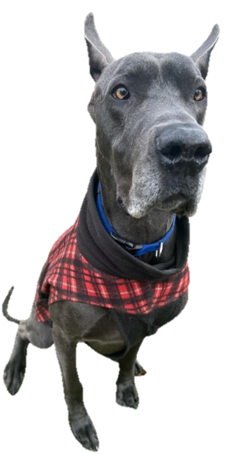
Calling Methods
All the methods above are now part of our Dog class, and when we create Dog objects, we can call on the methods using the reference we created to the Dog object
public class Driver
{
public static void main(String[] args)
{
Dog dogOne = new Dog("Mila", 9, true);
Dog dogTwo = new Dog("Jax", 4, true);
Dog dogThree = new Dog("Olive", 10, false);
}
}
dogTwo
name = "Jax" age = 4 goodDog = true
Dog
String name int age booelan goodDog

Slide 48

Calling Methods
All the methods above are now part of our Dog class, and when we create Dog objects, we can call on the methods using the reference we created to the Dog object
public class Driver
{
public static void main(String[] args)
{
Dog dogOne = new Dog("Mila", 9, true);
Dog dogTwo = new Dog("Jax", 4, true);
Dog dogThree = new Dog("Olive", 10, false);
}
}
dogThree
name = "Olive" age = 10 goodDog = false
Dog
String name int age booelan goodDog

Slide 49
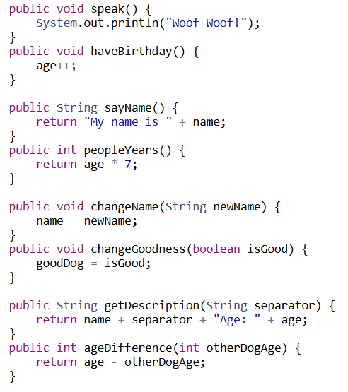
Code | What does it do?
dogOne.speak();
dogOne
dogTwo
dogThree
name = "Mila" age = 9 goodDog = true
name = "Jax" age = 4 goodDog = true
name = "Olive" age = 10 goodDog = false

Slide 50
Code | What does it do?
dogOne.speak();
dogOne
dogTwo
dogThree
name = "Mila" age = 9 goodDog = true
name = "Jax" age = 4 goodDog = true
name = "Olive" age = 10 goodDog = false

Slide 51
Code | What does it do?
dogOne.speak(); | Woof Woof! gets displayed
dogOne
dogTwo
dogThree
name = "Mila" age = 9 goodDog = true
name = "Jax" age = 4 goodDog = true
name = "Olive" age = 10 goodDog = false

Slide 52
Code | What does it do?
dogTwo.haveBirthday();
dogOne
dogTwo
dogThree
name = "Mila" age = 9 goodDog = true
name = "Jax" age = 4 goodDog = true
name = "Olive" age = 10 goodDog = false

Slide 53
Code | What does it do?
dogTwo.haveBirthday();
dogOne
dogTwo
dogThree
name = "Mila" age = 9 goodDog = true
name = "Jax" age = 4 goodDog = true
name = "Olive" age = 10 goodDog = false

Slide 54
Code | What does it do?
dogTwo.haveBirthday();
dogOne
dogTwo
dogThree
name = "Mila" age = 9 goodDog = true
name = "Jax" age = 4 goodDog = true
name = "Olive" age = 10 goodDog = false

Slide 55
Code | What does it do?
dogTwo.haveBirthday(); | dogTwo’s age goes from 4 to 5
dogOne
dogTwo
dogThree
name = "Mila" age = 9 goodDog = true
name = "Jax" age = 5 goodDog = true
name = "Olive" age = 10 goodDog = false

Slide 56
Code | What does it do?
System.out.println(dogThree.sayName());
dogOne
dogTwo
dogThree
name = "Mila" age = 9 goodDog = true
name = "Jax" age = 5 goodDog = true
name = "Olive" age = 10 goodDog = false

Slide 57
Code | What does it do?
System.out.println(dogThree.sayName());
dogOne
dogTwo
dogThree
name = "Mila" age = 9 goodDog = true
name = "Jax" age = 5 goodDog = true
name = "Olive" age = 10 goodDog = false

Slide 58
Code | What does it do?
System.out.println(dogThree.sayName()); | I am Olive gets displayed
dogOne
dogTwo
dogThree
name = "Mila" age = 9 goodDog = true
name = "Jax" age = 5 goodDog = true
name = "Olive" age = 10 goodDog = false

Slide 59
Code | What does it do?
System.out.println("I am " + dogOne.peopleYears());
dogOne
dogTwo
dogThree
name = "Mila" age = 9 goodDog = true
name = "Jax" age = 5 goodDog = true
name = "Olive" age = 10 goodDog = false

Slide 60
Code | What does it do?
System.out.println("I am " + dogOne.peopleYears());
dogOne
dogTwo
dogThree
name = "Mila" age = 9 goodDog = true
name = "Jax" age = 5 goodDog = true
name = "Olive" age = 10 goodDog = false

Slide 61
Code | What does it do?
System.out.println("I am " + dogOne.peopleYears()); | dogOne.peopleYears() will return 63, so I am 63 gets printed
dogOne
dogTwo
dogThree
name = "Mila" age = 9 goodDog = true
name = "Jax" age = 5 goodDog = true
name = "Olive" age = 10 goodDog = false

Slide 62
Code | What does it do?
dogTwo.changeName("Hank");
dogOne
dogTwo
dogThree
name = "Mila" age = 9 goodDog = true
name = "Jax" age = 5 goodDog = true
name = "Olive" age = 10 goodDog = false

Slide 63
Code | What does it do?
dogTwo.changeName("Hank");
dogOne
dogTwo
dogThree
name = "Mila" age = 9 goodDog = true
name = "Jax" age = 5 goodDog = true
name = "Olive" age = 10 goodDog = false

Slide 64
Code | What does it do?
dogTwo.changeName("Hank");
dogOne
dogTwo
dogThree
name = "Mila" age = 9 goodDog = true
name = "Jax" age = 5 goodDog = true
name = "Olive" age = 10 goodDog = false

Slide 65
Code | What does it do?
dogTwo.changeName("Hank"); | dogTwo’s name gets changed to Hank
dogOne
dogTwo
dogThree
name = "Mila" age = 9 goodDog = true
name = "Hank" age = 5 goodDog = true
name = "Olive" age = 10 goodDog = false

Slide 66
Code | What does it do?
dogThree.changeGoodness(true);
dogOne
dogTwo
dogThree
name = "Mila" age = 9 goodDog = true
name = "Hank" age = 5 goodDog = true
name = "Olive" age = 10 goodDog = false

Slide 67
Code | What does it do?
dogThree.changeGoodness(true);
dogOne
dogTwo
dogThree
name = "Mila" age = 9 goodDog = true
name = "Hank" age = 5 goodDog = true
name = "Olive" age = 10 goodDog = false

Slide 68
Code | What does it do?
dogThree.changeGoodness(true);
dogOne
dogTwo
dogThree
name = "Mila" age = 9 goodDog = true
name = "Hank" age = 5 goodDog = true
name = "Olive" age = 10 goodDog = false

Slide 69
Code | What does it do?
dogThree.changeGoodness(true); | dogThree’s goodDog is changes to true
dogOne
dogTwo
dogThree
name = "Mila" age = 9 goodDog = true
name = "Hank" age = 5 goodDog = true
name = "Olive" age = 10 goodDog = true

Slide 70
Code | What does it do?
System.out.println(dogTwo.getDescription(" * "));
dogOne
dogTwo
dogThree
name = "Mila" age = 9 goodDog = true
name = "Hank" age = 5 goodDog = true
name = "Olive" age = 10 goodDog = true

Slide 71
Code | What does it do?
System.out.println(dogTwo.getDescription(" * "));
dogOne
dogTwo
dogThree
name = "Mila" age = 9 goodDog = true
name = "Hank" age = 5 goodDog = true
name = "Olive" age = 10 goodDog = true

Slide 72
Code | What does it do?
System.out.println(dogTwo.getDescription(" * ")); | Hank * Age: 5 gets printed since his age and name were both changed
dogOne
dogTwo
dogThree
name = "Mila" age = 9 goodDog = true
name = "Hank" age = 5 goodDog = true
name = "Olive" age = 10 goodDog = true

Slide 73
Code | What does it do?
System.out.print(dogOne.ageDifference(3));
dogOne
dogTwo
dogThree
name = "Mila" age = 9 goodDog = true
name = "Hank" age = 5 goodDog = true
name = "Olive" age = 10 goodDog = true

Slide 74
Code | What does it do?
System.out.print(dogOne.ageDifference(3));
dogOne
dogTwo
dogThree
name = "Mila" age = 9 goodDog = true
name = "Hank" age = 5 goodDog = true
name = "Olive" age = 10 goodDog = true

Slide 75
Code | What does it do?
System.out.print(dogOne.ageDifference(3)); | dogOne’s age is 9, so the method will return 9 – 3 and print 6 to the screen
dogOne
dogTwo
dogThree
name = "Mila" age = 9 goodDog = true
name = "Hank" age = 5 goodDog = true
name = "Olive" age = 10 goodDog = true

Slide 76
Return Statements
What is returned in the return statement must match what is indicated to be returned in the method header.

Slide 77
Return Statements
What is returned in the return statement must match what is indicated to be returned in the method header.
The return statement must always be the last line of code.

Slide 78
Return Statements
What is returned in the return statement must match what is indicated to be returned in the method header.
The return statement must always be the last line of code.
The value you return to the calling method must “fit” in the value of the variable you have capturing it

Slide 79
Return Statements
What is returned in the return statement must match what is indicated to be returned in the method header.
The return statement must always be the last line of code.
The value you return to the calling method must “fit” in the value of the variable you have capturing it
  For example, if you return an integer, you can have a double variable catch it

Slide 80
Return Statements
What is returned in the return statement must match what is indicated to be returned in the method header.
The return statement must always be the last line of code.
The value you return to the calling method must “fit” in the value of the variable you have capturing it
  For example, if you return an integer, you can have a double variable catch it
You can put the following in a void method:
  return void;
  return;

Slide 81
Overloaded Methods

Slide 82
Overloaded Methods
Methods are overloaded when there are multiple methods with the same name but a different set of parameters

Slide 83
Overloaded Methods
Methods are overloaded when there are multiple methods with the same name but a different set of parameters
The complier only is able to choose the correct method based on the amount of parameters and their types

Slide 84
Overloaded Methods
Methods are overloaded when there are multiple methods with the same name but a different set of parameters
The complier only is able to choose the correct method based on the amount of parameters and their types
The compiler cannot distinguish between return types or variable names in the method signature

Slide 85
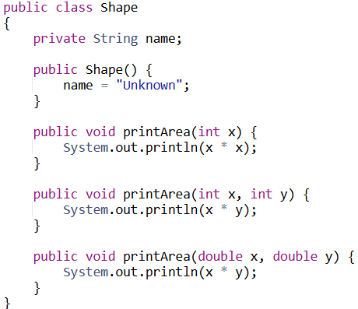
Consider the following code, which is located in the main method of a separate class. What is run when the code is executed?
Shape one = new Shape();

Slide 86
Consider the following code, which is located in the main method of a separate class. What is run when the code is executed?
Shape one = new Shape();
A new shape called one is created

Slide 87
Consider the following code, which is located in the main method of a separate class. What is run when the code is executed?
Shape one = new Shape();
A new shape called one is created
one.printArea(2);

Slide 88
Consider the following code, which is located in the main method of a separate class. What is run when the code is executed?
Shape one = new Shape();
A new shape called one is created
one.printArea(2);

Slide 89
Consider the following code, which is located in the main method of a separate class. What is run when the code is executed?
Shape one = new Shape();
A new shape called one is created
one.printArea(2);
4 is printed

Slide 90
Consider the following code, which is located in the main method of a separate class. What is run when the code is executed?
Shape one = new Shape();
A new shape called one is created
one.printArea(2);
4 is printed
one.printArea(5, 6);

Slide 91
Consider the following code, which is located in the main method of a separate class. What is run when the code is executed?
Shape one = new Shape();
A new shape called one is created
one.printArea(2);
4 is printed
one.printArea(5, 6);

Slide 92
Consider the following code, which is located in the main method of a separate class. What is run when the code is executed?
Shape one = new Shape();
A new shape called one is created
one.printArea(2);
4 is printed
one.printArea(5, 6);
30 is printed

Slide 93
Consider the following code, which is located in the main method of a separate class. What is run when the code is executed?
Shape one = new Shape();
A new shape called one is created
one.printArea(2);
4 is printed
one.printArea(5, 6);
30 is printed
one.printArea(1.5, 4.0);

Slide 94
Consider the following code, which is located in the main method of a separate class. What is run when the code is executed?
Shape one = new Shape();
A new shape called one is created
one.printArea(2);
4 is printed
one.printArea(5, 6);
30 is printed
one.printArea(1.5, 4.0);

Slide 95
Consider the following code, which is located in the main method of a separate class. What is run when the code is executed?
Shape one = new Shape();
A new shape called one is created
one.printArea(2);
4 is printed
one.printArea(5, 6);
30 is printed
one.printArea(1.5, 4.0);
6.0 is printed

Slide 96
You are considering add the following method signatures to the Shape class. Which of these are valid method overloading examples? Explain.
public void printArea(double z)

Slide 97
You are considering add the following method signatures to the Shape class. Which of these are valid method overloading examples? Explain.
public void printArea(double z)
VALID. There is not a method signature with a single double yet, so we could add this.

Slide 98
You are considering add the following method signatures to the Shape class. Which of these are valid method overloading examples? Explain.
public int printArea(int x)

Slide 99
You are considering add the following method signatures to the Shape class. Which of these are valid method overloading examples? Explain.
public int printArea(int x)
INVALID. There is already a method signature with a single integer parameter. Having a different return type does not matter.

Slide 100
You are considering add the following method signatures to the Shape class. Which of these are valid method overloading examples? Explain.
private void printArea(int z)

Slide 101
You are considering add the following method signatures to the Shape class. Which of these are valid method overloading examples? Explain.
private void printArea(int z)
INVALID. The compiler does not distinguish between visibility modifiers.

Slide 102
You are considering add the following method signatures to the Shape class. Which of these are valid method overloading examples? Explain.
public void printArea(double x, double y, double z)

Slide 103
You are considering add the following method signatures to the Shape class. Which of these are valid method overloading examples? Explain.
public void printArea(double x, double y, double z)
VALID. There is not a method signature with three double variables yet, so we could add this.

Slide 104
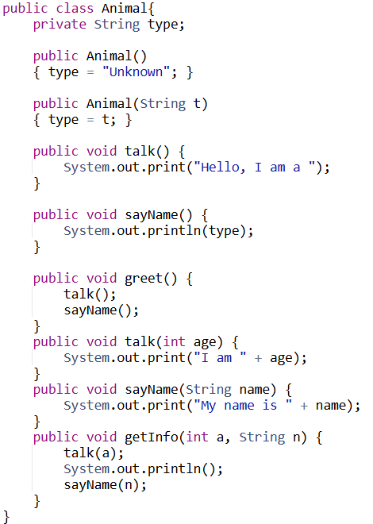
What does the follow code segments print? (Assume the Animal object is created in a class other than Animal.)
Animal a = new Animal();
a.talk();
a.sayName();

Slide 105
What does the follow code segments print? (Assume the Animal object is created in a class other than Animal.)
Animal a = new Animal();
a.talk();
a.sayName();
a
type = "Unknown"
Console:

Slide 106
What does the follow code segments print? (Assume the Animal object is created in a class other than Animal.)
Animal a = new Animal();
a.talk();
a.sayName();
a
type = "Unknown"
Console:
Hello, I am a

Slide 107
What does the follow code segments print? (Assume the Animal object is created in a class other than Animal.)
Animal a = new Animal();
a.talk();
a.sayName();
a
type = "Unknown"
Console:
Hello, I am a Unknown

Slide 108
What does the follow code segments print? (Assume the Animal object is created in a class other than Animal.)
Animal b = null;
b.talk();

Slide 109
What does the follow code segments print? (Assume the Animal object is created in a class other than Animal.)
Animal b = null;
b.talk();
b

Slide 110
What does the follow code segments print? (Assume the Animal object is created in a class other than Animal.)
Animal b = null;
b.talk();
b
Console:
NullPointerException

Slide 111
What does the follow code segments print? (Assume the Animal object is created in a class other than Animal.)
Animal c = new Animal("Kitten");
Animal d = new Animal();
d.sayName();
c.talk();
c.sayName();

Slide 112
What does the follow code segments print? (Assume the Animal object is created in a class other than Animal.)
Animal c = new Animal("Kitten");
Animal d = new Animal();
d.sayName();
c.talk();
c.sayName();
c
type = "Kitten"
d
type = "Unknown"

Slide 113
What does the follow code segments print? (Assume the Animal object is created in a class other than Animal.)
Animal c = new Animal("Kitten");
Animal d = new Animal();
d.sayName();
c.talk();
c.sayName();
c
type = "Kitten"
d
type = "Unknown"
Console:
Unknown

Slide 114
What does the follow code segments print? (Assume the Animal object is created in a class other than Animal.)
Animal c = new Animal("Kitten");
Animal d = new Animal();
d.sayName();
c.talk();
c.sayName();
c
type = "Kitten"
d
type = "Unknown"
Console:
Unknown
Hello, I am a

Slide 115
What does the follow code segments print? (Assume the Animal object is created in a class other than Animal.)
Animal c = new Animal("Kitten");
Animal d = new Animal();
d.sayName();
c.talk();
c.sayName();
c
type = "Kitten"
d
type = "Unknown"
Console:
Unknown
Hello, I am a Kitten

Slide 116
What does the follow code segments print? (Assume the Animal object is created in a class other than Animal.)
Animal f = new Animal("Whale");
f.greet();

Slide 117
What does the follow code segments print? (Assume the Animal object is created in a class other than Animal.)
C
Animal f = new Animal("Whale");
f.greet();
f
type = "Whale"

Slide 118
What does the follow code segments print? (Assume the Animal object is created in a class other than Animal.)
Animal f = new Animal("Whale");
f.greet();
C
f
type = "Whale"
Console:

Slide 119
What does the follow code segments print? (Assume the Animal object is created in a class other than Animal.)
Animal f = new Animal("Whale");
f.greet();
C
f
type = "Whale"
Console:
Hello, I am a

Slide 120
What does the follow code segments print? (Assume the Animal object is created in a class other than Animal.)
Animal f = new Animal("Whale");
f.greet();
C
f
type = "Whale"
Console:
Hello, I am a Whale

Slide 121
What does the follow code segments print? (Assume the Animal object is created in a class other than Animal.)
Animal g = new Animal("Zebra");
g.talk(4);
g.talk();

Slide 122
What does the follow code segments print? (Assume the Animal object is created in a class other than Animal.)
Animal g = new Animal("Zebra");
g.talk(4);
g.talk();
g
type = "Zebra"

Slide 123
What does the follow code segments print? (Assume the Animal object is created in a class other than Animal.)
Animal g = new Animal("Zebra");
g.talk(4);
g.talk();
g
type = "Zebra"
C
Console:
I am 4

Slide 124
What does the follow code segments print? (Assume the Animal object is created in a class other than Animal.)
Animal g = new Animal("Zebra");
g.talk(4);
g.talk();
g
type = "Zebra"
Console:
I am 4 Hello, I am a

Slide 125
What does the follow code segments print? (Assume the Animal object is created in a class other than Animal.)
Animal h = new Animal("Rat");
h.sayName("Queenie");

Slide 126
What does the follow code segments print? (Assume the Animal object is created in a class other than Animal.)
Animal h = new Animal("Rat");
h.sayName("Queenie");
h
type = "Rat"

Slide 127
What does the follow code segments print? (Assume the Animal object is created in a class other than Animal.)
Animal h = new Animal("Rat");
h.sayName("Queenie");
h
type = "Rat"
Console:
My name is Queenie

Slide 128
What does the follow code segments print? (Assume the Animal object is created in a class other than Animal.)
Animal j = new Animal();
j.getInfo(3, "Gus");

Slide 129
What does the follow code segments print? (Assume the Animal object is created in a class other than Animal.)
Animal j = new Animal();
j.getInfo(3, "Gus");
j
type = "Unknown"

Slide 130
What does the follow code segments print? (Assume the Animal object is created in a class other than Animal.)
Animal j = new Animal();
j.getInfo(3, "Gus");
j
type = "Unknown"
Console:

Slide 131
What does the follow code segments print? (Assume the Animal object is created in a class other than Animal.)
Animal j = new Animal();
j.getInfo(3, "Gus");
j
type = "Unknown"
Console:
I am 3

Slide 132
What does the follow code segments print? (Assume the Animal object is created in a class other than Animal.)
Animal j = new Animal();
j.getInfo(3, "Gus");
j
type = "Unknown"
Console:
I am 3

Slide 133
What does the follow code segments print? (Assume the Animal object is created in a class other than Animal.)
Animal j = new Animal();
j.getInfo(3, "Gus");
j
type = "Unknown"
Console:
I am 3

Slide 134
What does the follow code segments print? (Assume the Animal object is created in a class other than Animal.)
Animal j = new Animal();
j.getInfo(3, "Gus");
j
type = "Unknown"
Console:
I am 3
My name is Gus

Slide 135
Commenting Techniques in Java
Comments make code easier to understand for both the original programmer and others who read it later
The compiler ignores all comments, so they do not affect how the program runs

Slide 136
Commenting Techniques in Java
Comments make code easier to understand for both the original programmer and others who read it later
The compiler ignores all comments, so they do not affect how the program runs
Block Comments
Used for large explanations or multiline comments
/* This method calculates the area of a rectangle */

Slide 137
Commenting Techniques in Java
Comments make code easier to understand for both the original programmer and others who read it later
The compiler ignores all comments, so they do not affect how the program runs
Block Comments | Single-Line Comments
Used for large explanations or multiline comments | Used for brief notes
/* This method calculates the area of a rectangle */ | // This is the length int x = 10;

Slide 138
Javadoc Comments
Used for API documentation, used to describe classes, methods, and fields

Slide 139
Javadoc Comments
Used for API documentation, used to describe classes, methods, and fields
/** * Calculates the area of a rectangle. * @param length The length of the rectangle * @param width The width of the rectangle * @return The calculated area */ public int calculateArea(int length, int width) { return length * width; }

Slide 140
Javadoc Comments
Used for API documentation, used to describe classes, methods, and fields
/** * Calculates the area of a rectangle. * @param length The length of the rectangle * @param width The width of the rectangle * @return The calculated area */ public int calculateArea(int length, int width) { return length * width; }
Special notation to indicate what the parameter represents

Slide 141
Javadoc Comments
Used for API documentation, used to describe classes, methods, and fields
/** * Calculates the area of a rectangle. * @param length The length of the rectangle * @param width The width of the rectangle * @return The calculated area */ public int calculateArea(int length, int width) { return length * width; }
Special notation to indicate what the returned value represents

Slide 142
Preconditions A precondition is something that must be true before running a method for it to work as expected. Programmers do not expect methods to verify preconditions themselves. Postconditions A postcondition is something that must be true after a method finishes running. It describes the result or effects of the method. | /* Precondition: width and height must be positive ** Postcondition: The method returns the correct area ** of the rectangle */ public int calculateArea(int width, int height) { return width * height; }

Slide 143
Preconditions A precondition is something that must be true before running a method for it to work as expected. Programmers do not expect methods to verify preconditions themselves. Postconditions A postcondition is something that must be true after a method finishes running. It describes the result or effects of the method. | /* Precondition: width and height must be positive ** Postcondition: The method returns the correct area ** of the rectangle */ public int calculateArea(int width, int height) { return width * height; }

